Slide 1

Avarice
By Nathan Nguyen &

Slide 2

The team
Nathan Nguyen
3rd year Computer Science student
Jacob Junker
[Fill Here] student

Slide 3
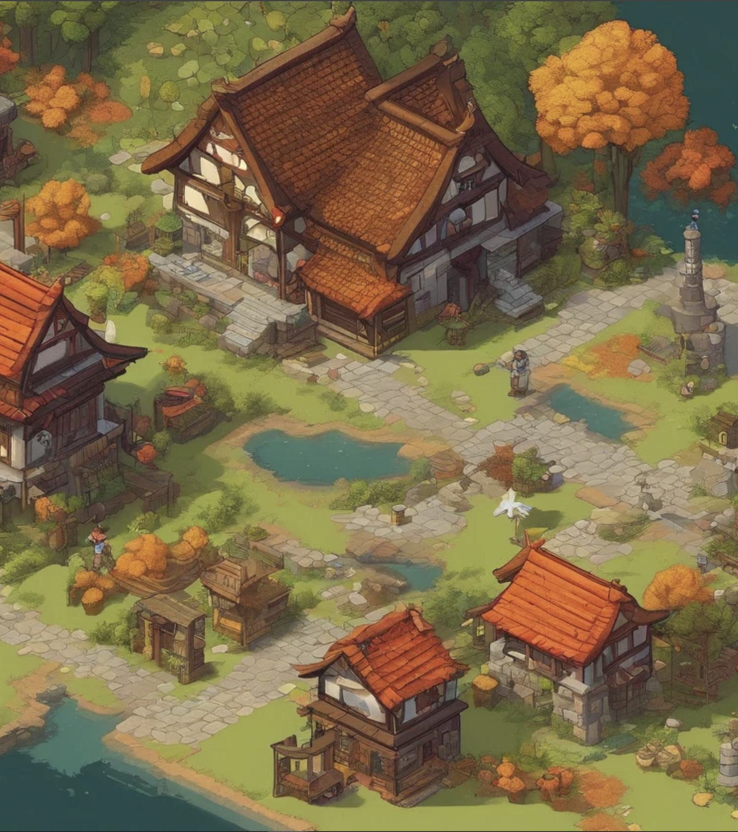
About Avarice
The next amazing 2D story-driven RPG fantasy game!

Slide 4
Pitch
Are you ready to dive into a world where every choice has a consequence? Welcome to "Avarice," a captivating medieval adventure that blends thrilling combat with deep economic strategy, all set in a stunning 16-bit fantasy world reminiscent of the beloved Stardew Valley.
In "Avarice," you play as a daring adventurer who becomes the unexpected hero of a town besieged by monsters. By defending caravans and battling dungeon beasts, you not only protect the town but also drive its economy. However, the allure of a mysterious cavern filled with untold riches draws you deeper into danger. Here, your choices will decide the town’s fate.
This game offers a unique leveling system where you enhance your combat and bartering skills, navigating through a non-linear storyline with real impact. Face a deceptive final boss whose defeat could either mean prosperity for the town or its eerie abandonment. Designed for players aged 13 and up, "Avarice" is not just about fighting monsters—it’s about facing the consequences of your ambition.
Step into "Avarice" where your adventures shape the world. Will you be its savior, or will your quest for wealth doom the very place you strive to protect? Join us in "Avarice" and carve your path through a world rich with challenges and choices. Ready to shape your destiny? Play "Avarice" now!

Slide 5
Interested? Tell me More!
"Avarice" is an adventure survival game set in a 16-bit high fantasy world reminiscent of Stardew Valley, designed for PC. Targeted at players aged 13 and above, it offers a rich blend of exploration, strategy, and narrative depth.
Game Concept:
Embark on an epic adventure as a wandering adventurer drawn to a town plagued by monsters.
Navigate through dungeons, defend merchant caravans, and engage in a dynamic local economy to protect and sustain the town.
Rumors of a mysterious cavern filled with untold riches drive you into deeper perils, testing your skills and moral choices.
Core Gameplay:
Exploration and Combat: Traverse a medieval fantasy world, facing monsters and uncovering hidden treasures and secrets.
Economy and Upgrades: Participate in the town's economy through strategic trading and upgrading of gear, balancing combat efficiency with economic savvy.
Decision Impact: Choices directly affect the game’s world and narrative, leading to multiple potential endings based on your actions.
Unique Selling Points:
Non-linear story progression allows for a personalized gameplay experience.
Engaging combat system paired with a comprehensive economic model.
Moral choices that impact the game ending, emphasizing the consequences of ambition.

Slide 6
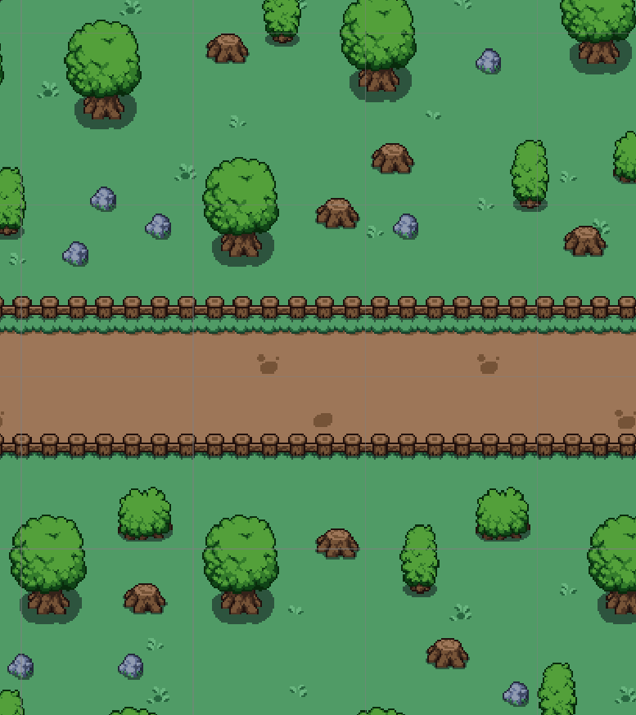
Avarice Demo
Game Concept
Level Design
Logic
Scene Switching
UI
Animations
Player movement/Input Handling
AI/Auto Scripting
Cinematics/Camera Control
Story/Character Dialog
NOTE: ChatGPT was NOT used in any part of the creation

Slide 7
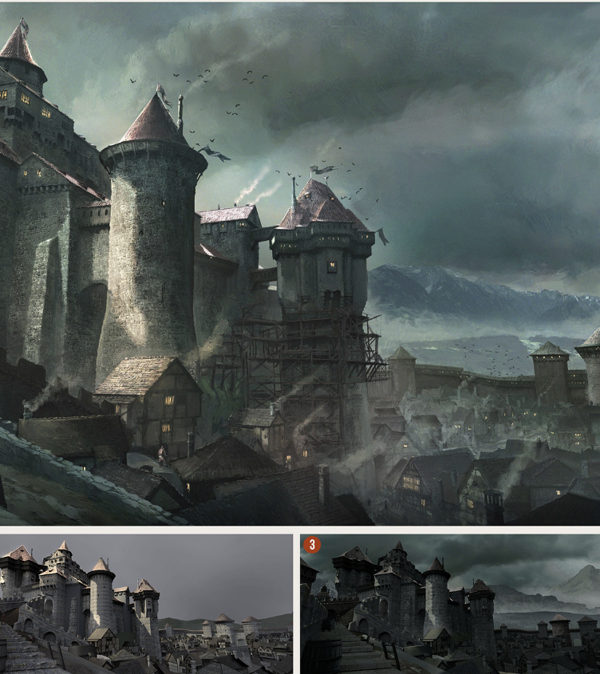
Future Direction
While the playthrough I showed was a basic demo with one level, I plan on expanding it much more!
Plans for future:
Main Village with interactable NPCs
Exploration areas
Boss fights
More enemies
And much more!

